Slide 1
COVID-19 Future Forecasting Using Supervised Machine Learning Models
Contributors
Jagadeesh Allam
Sameer Raja Shaik
Shirisha Baddam
Yasasri Uma Paruchuri

Slide 2
Discussion on
1. Abstract
2. Introduction
3. Learning Objectives
4. Proposed Workflow
5. Methodologies
6. Conclusion
7. References

Slide 3
Abstract
Machine learning based forecasting mechanisms are better which helps in decision making actions in future. Machine learning models are being applied in vast domains. Currently many prediction methods are being used to solve the forecasting problems. This research study demonstrates the Machine Learning capability to forecast the number of upcoming patients affected by COVID-19, which is presently a dangerous threat to human mankind. In detail four forecasting algorithms are used, like Linear Regression (LR), Least Absolute Shrinkage and Selection Operator (LASSO), Support Vector Machine (SVM), and Exponential Smoothing (ES) have been used in the study to do the forecasting task. There are three types of predictions made by each model we are using, such as number of newly infected cases, the number of deaths, and the number of recoveries in the next 10 days. The study's findings show that using these strategies in the present COVID-19 pandemic scenario is a potential mechanism. The results show that the Exponential Smoothing (ES) outperforms all other models, followed by LR and LASSO, which excel at forecasting new confirmed cases, death rates, and recovery rates, respectively, while SVM performs badly in all prediction scenarios given the provided information.

Slide 4
Introduction
ML algorithms’ learning is typically based on trial and error method which is quite opposite of conventional algorithms, which follows live forecasting of COVID-19 confirmed cases and study is also focused on the forecast of COVID-19 outbreak and early response.
These prediction systems can be very helpful in decision making to handle the present scenario to guide early interventions to manage these diseases very effectively. This study aims to provide an early forecast model for the spread of novel coronavirus, also known as SARS-CoV-2, officially named as COVID-19 by the World Health Organization (WHO).
To contribute to the current human crisis our attempt in this study is to develop a forecasting system for COVID-19. The forecasting is done for the three important variables of the disease for the coming 10 days:
1. The number of New confirmed cases.
2. The number of death cases.
3. The number of recoveries.

Slide 5
Paper Overview
This problem of forecasting has been considered as a regression problem in this study, so the study is based on some state-of-art supervised ML regression models such as:
1. Linear regression (LR)
2. Least Absolute Shrinkage and Selection Operator (LASSO)
3. Support Vector Machine (SVM)
4. Exponential smoothing (ES).
The learning models have been trained using the COVID-19 patient stats dataset provided by Johns Hopkins.
The dataset has been preprocessed and divided into two subsets:
Training Set (85% records)
Testing Set (15% records).
The performance evaluation has been done in terms of important measures including
R-squared score (R2 score)
Adjusted R-squared Score (R2 adjusted ),
Mean Square Error (MSE)
Mean Absolute Error (MAE)
Root Mean Square Error (RMSE).

Slide 6
Learning Objectives
The study forecasts thus can also be of great help for the authorities to take timely actions and make decisions to contain the COVID-19 crisis.
This study will be enhanced continuously in the future course, next we plan to explore the prediction methodology using the updated dataset and use the most accurate and appropriate ML methods for forecasting.
Real-time live forecasting will be one of the primary focuses in our future work.
In this study, an ML-based prediction system has been proposed for predicting the risk of COVID-19 outbreak globally. The system analyses dataset containing the day-wise actual past data and makes predictions for upcoming days using machine learning algorithms.

Slide 7
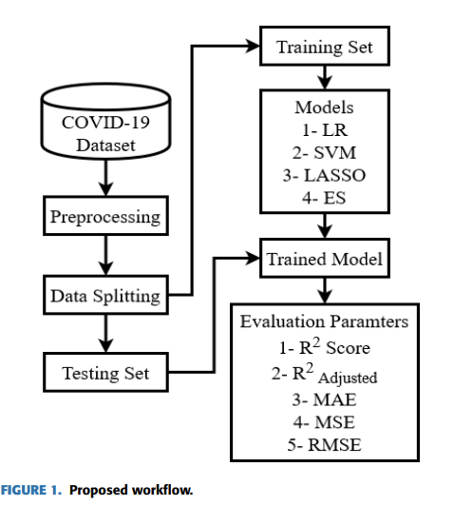
Proposed System Workflow

Slide 8
Methodologies
This study is based on some state-of-art supervised ML regression models such as linear regression (LR), least absolute shrinkage and selection operator (LASSO), support vector machine (SVM), and exponential smoothing (ES).
Supervised Learning Models:
• Linear Regression
• LASSO Regression
• Support Vector Machine
• Exponential Smoothing

Slide 9
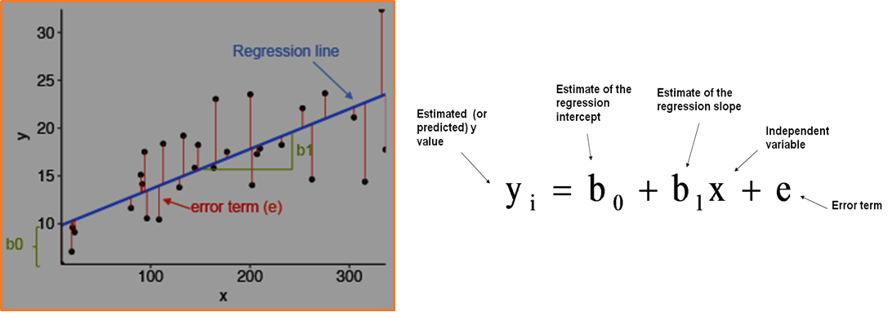
Linear Regression
The independent characteristics are used to predict a target class in regression modeling. As a result, this approach can be used to determine the relationship between independent and dependent variables, as well as to forecast. In linear regression, each observation is based on two values: the dependent variable and the independent variable. A linear relation between these dependent and independent variables is determined using linear regression.
Equation below shows the relationship
y = β0 + β1x + ε

Slide 10
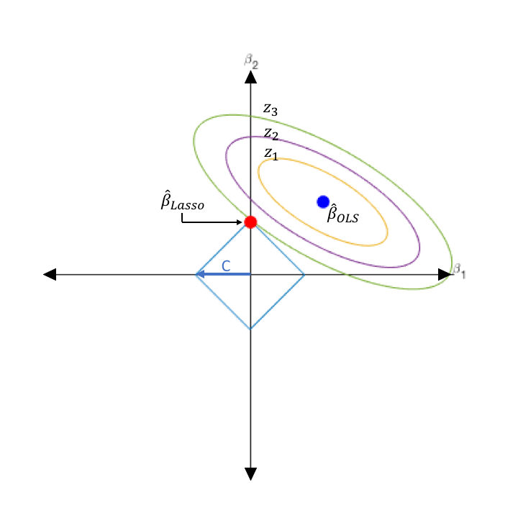
LASSO
LASSO is a regression model that uses shrinkage in the linear regression technique. The term "shrinkage" refers to the process of bringing extreme values of a data sample closer to the center. As a result of the shrinking process, LASSO becomes better and more stable, as well as reducing errors.
It utilizes a regularization approach to penalize the excess features automatically. That is, attributes that are insufficiently helpful to the regression findings might be assigned to a very low value, possibly zero.

Slide 11
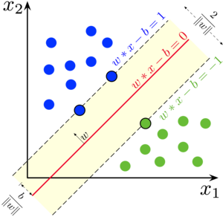
Support Vector Machine
The support vector machine (SVM) is a supervised machine learning technique that may be used for regression and classification. As a non-parametric approach, SVM regression relies on a collection of mathematical functions.
SVM handles regression issues using a linear function, it translates the input vector to an n-dimensional space termed a feature space when dealing with non-linear regression problems.

Slide 12
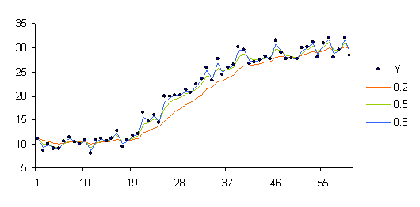

Exponential Smoothing
In Exponential smoothing, forecasting is done based on previous data. As time passes, the effect of previous data observations diminishes exponentially. Exponential smoothing is a powerful time series forecasting method.
The forecast for the current time

Slide 13
Evaluation Parameters
We evaluate the model performance in terms of :
R-Squared score
Adjusted R-Squared Score
Mean Absolute Error
Mean Square Error
Root Mean Square Error

Slide 14
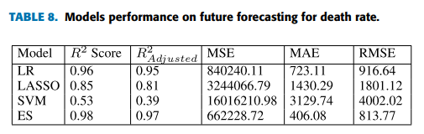
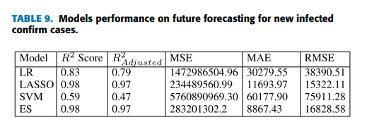
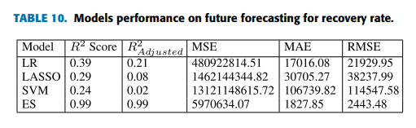
Model performance

Slide 15
Conclusion
The results of the study prove that ES performs best in the current forecasting domain given the nature and size of the dataset. LR and LASSO also perform well for forecasting to some extent to predict death rate and confirm cases. According to the results of these two models, the death rates will increase in upcoming days, and recoveries rate will be slowed down.
SVM produces poor results in all scenarios because of the ups and downs in the dataset values. It was very difficult to put an accurate hyperplane between the given values of the dataset. Overall, we conclude that model predictions according to the current scenario are correct which may be helpful to understand the upcoming situation
This research will be improved over time; next, we want to investigate prediction methodology utilizing the updated dataset and employ the most accurate and relevant machine learning algorithms for forecasting. One of the key areas of our future work will be real-time live forecasting.

Slide 16
References
[1] S. Makridakis, E. Spiliotis, and V. Assimakopoulos, ‘‘Statistical and machine learning forecasting methods: Concerns and ways forward,’’ PLoS ONE, vol. 13, no. 3, Mar. 2018, Art. no. e0194889.
[2] G. Bontempi, S. B. Taieb, and Y.-A. Le Borgne, ‘‘Machine learning strategies for time series forecasting,’’ in Proc. Eur. Bus. Intell. Summer School. Berlin, Germany: Springer, 2012, pp. 62–77.
[3] F. E. Harrell Jr, K. L. Lee, D. B. Matchar, and T. A. Reichert, ‘‘Regression models for prognostic prediction: Advantages, problems, and suggested solutions,’’ Cancer Treat. Rep., vol. 69, no. 10, pp. 1071–1077, 1985.
[4] P. Lapuerta, S. P. Azen, and L. Labree, ‘‘Use of neural networks in predicting the risk of coronary artery disease,’’ Comput. Biomed. Res., vol. 28, no. 1, pp. 38–52, Feb. 1995.
[5] K. M. Anderson, P. M. Odell, P. W. Wilson, and W. B. Kannel, ‘‘Cardiovascular disease risk profiles,’’ Amer. heart J., vol. 121, no. 1, pp. 293–298, 1991.
[6] H. Asri, H. Mousannif, H. A. Moatassime, and T. Noel, ‘‘Using machine learning algorithms for breast cancer risk prediction and diagnosis,’’ Procedia Comput. Sci., vol. 83, pp. 1064–1069, Jan. 2016.
[7] F. Petropoulos and S. Makridakis, ‘‘Forecasting the novel coronavirus COVID-19,’’ PLoS ONE, vol. 15, no. 3, Mar. 2020, Art. no. e0231236.
[8] G. Grasselli, A. Pesenti, and M. Cecconi, ‘‘Critical care utilization for the COVID-19 outbreak in lombardy, italy: Early experience and forecast during an emergency response,’’ JAMA, vol. 323, no. 16, p. 1545, Apr. 2020.
[9] WHO. Naming the Coronavirus Disease (Covid-19) and the Virus That Causes it. Accessed: Apr. 1, 2020. [Online]. Available: https:// www.who.int/emergencies/diseases/novel-coronavirus-2019/technic% alguidance/naming-the-coronavirus-disease-(covid-2019)-and-the-virusthat-cau%ses-it
[10] C. P. E. R. E. Novel, ‘‘The epidemiological characteristics of an outbreak of 2019 novel coronavirus diseases (Covid-19) in China,’’ Zhonghua Liu Xing Bing Xue Za Zhi= Zhonghua Liuxingbingxue Zazhi, vol. 41, no. 2, p. 145, 2020.

